Slide 1
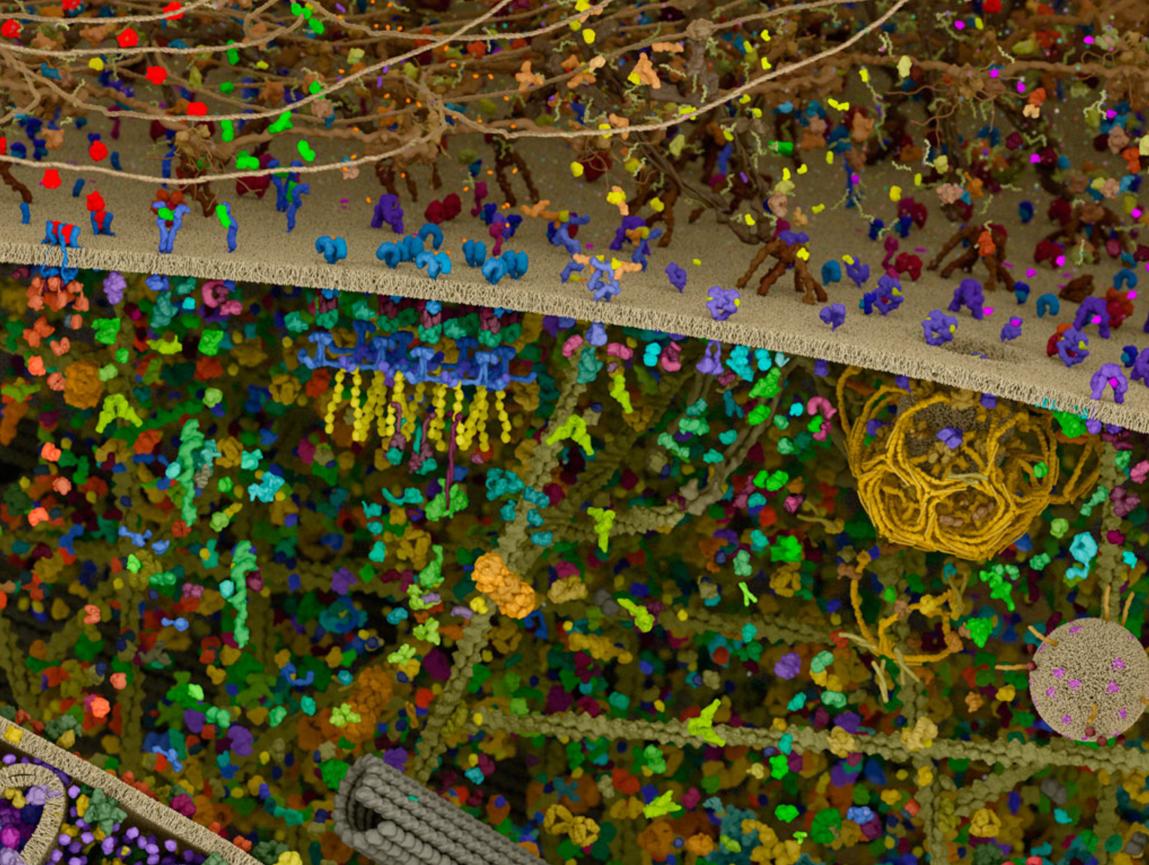




Investigating the limitations of (open) modification search engines for proteomics DIA data
Robbin Bouwmeester
Evan Ingersoll & Gael McGill - Digizyme

Slide 2

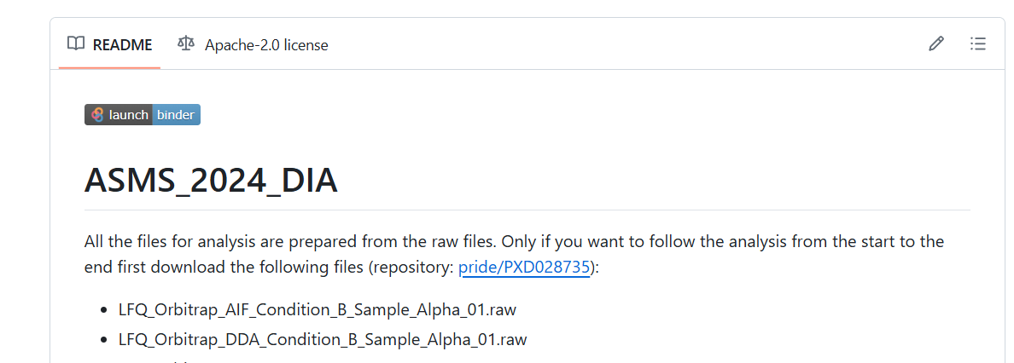
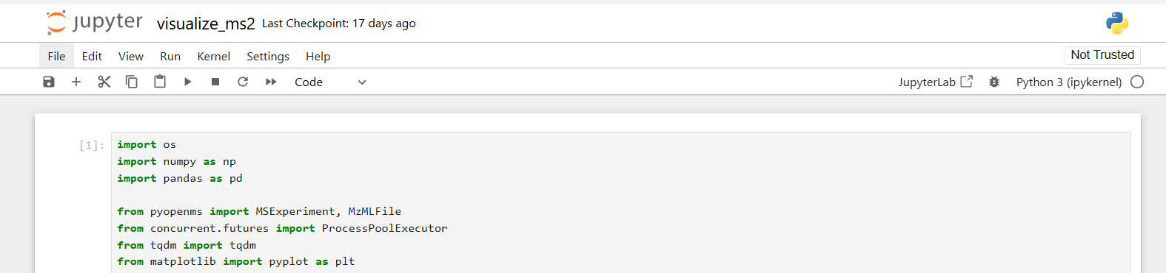
Replicate all analysis and figures in this presentation with these scripts and notebooks
github.com/RobbinBouwmeester/ASMS_2024_DIA
Notes:
DIA data is much more complex as it does not select a single precursor, but fragments multiple at the same time.

Slide 3
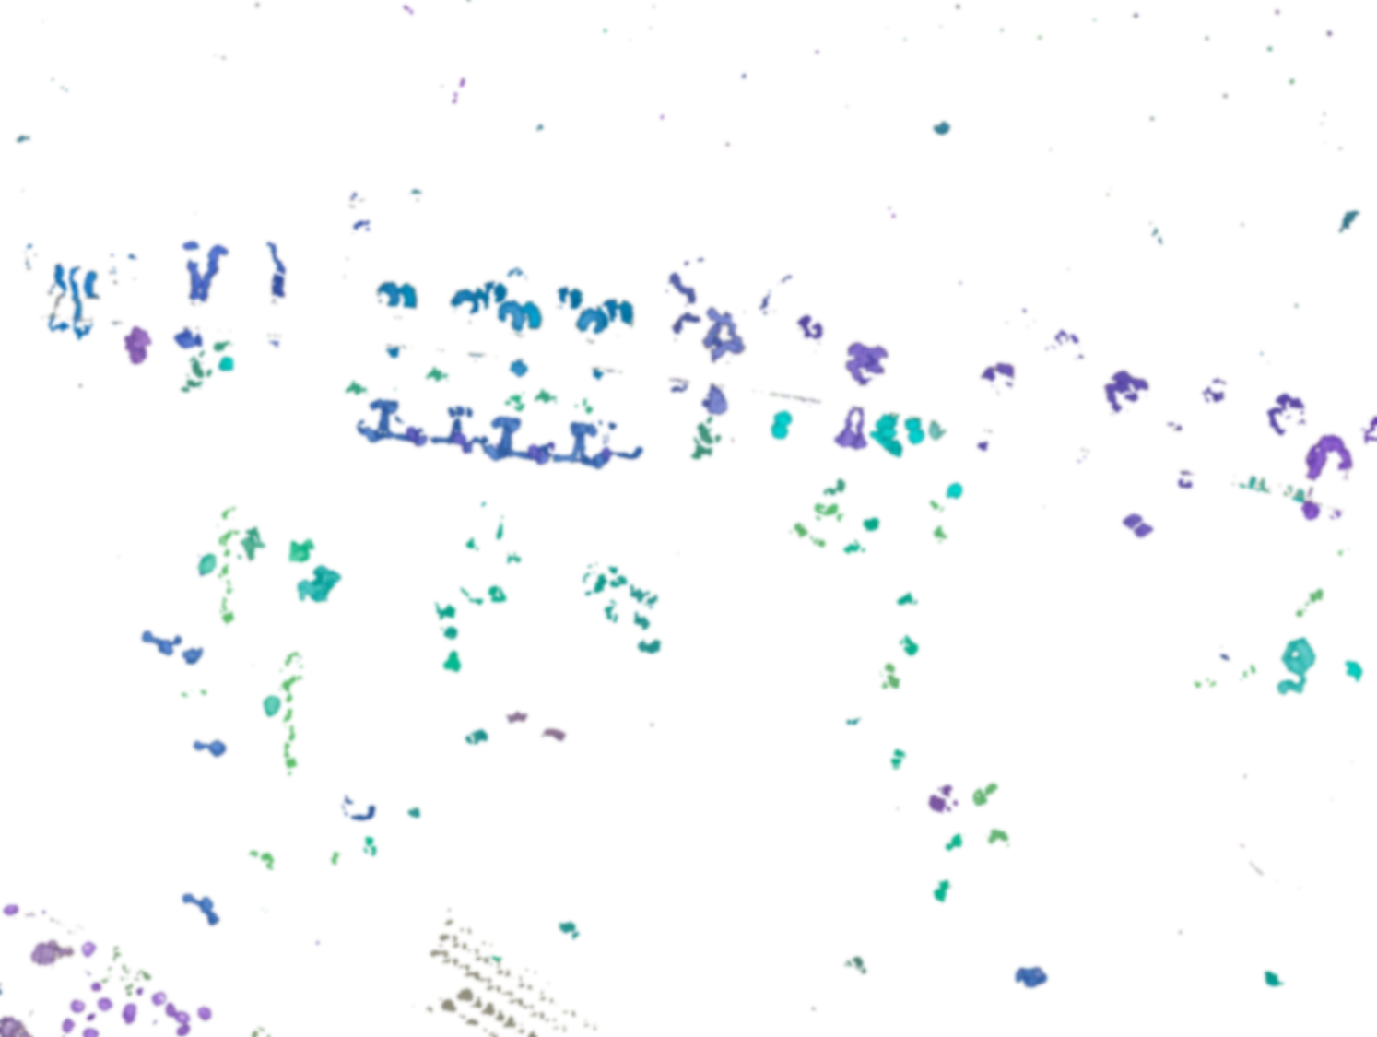
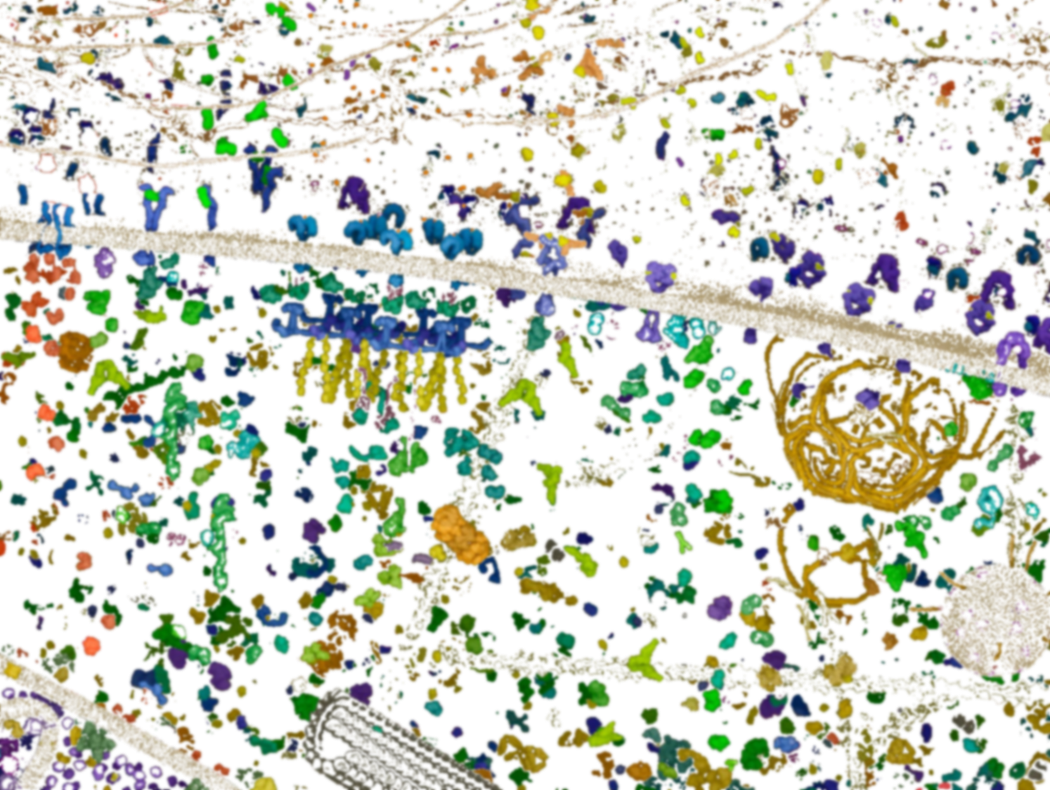
Data-Dependent Acquisition (DDA)
Data-Independent Acquisition (DIA)

Slide 4
Data-Dependent Acquisition (DDA)
Data-Independent Acquisition (DIA)
Scan cycle
DDA
Scan cycle
DIA
m/z
m/z

Slide 5
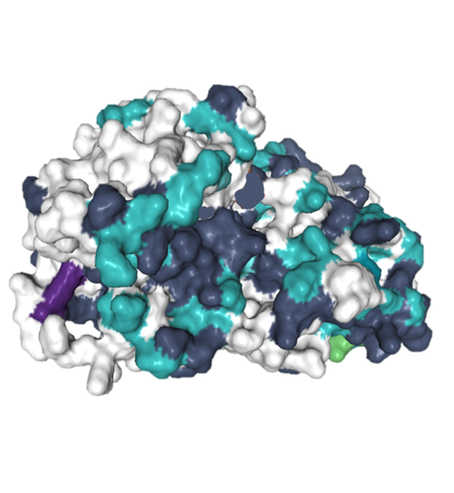
Data-Dependent Acquisition (DDA)
Data-Independent Acquisition (DIA)
Actin
Modification types (#)
1
2
3
>3
Ramasamy et al. JPR (2020)

Slide 6



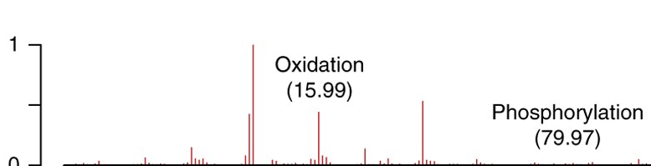
Three categories of open modificiation search strategies for DDA
1) Mass tolerant search
-150
+500
Kong et al. Nature Methods (2017); Lazear JPR (2023); Solntsev et al. JPR (2018);

Slide 7



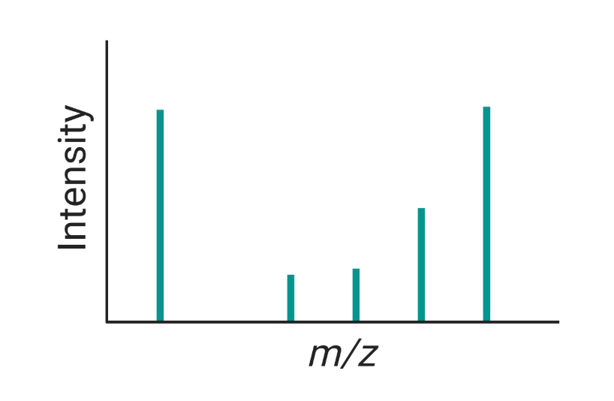

Three categories of open modificiation search strategies for DDA
1) Mass tolerant search
2) Multi-pass search
3) Tag-based search
Open-pFind
First-pass search
Tag prediction
-150
+500
Search space
Peptides + unexpected modifications
AGV X
LEN ✓
Kong et al. Nature Methods (2017); Lazear JPR (2023); Solntsev et al. JPR (2018); Chi et al. Nature Biotechnology (2018); Degroeve et al. bioRXiv (2022)

Slide 8



Existing methods for modification searches in DIA data are potentially less sensitive and costly
Experimental spectral library
DDA
Sensitivity and time+resources
DIA-NN
Kong et al. Nature Methods (2017); Demichev et al. Nature methods (2019)

Slide 9
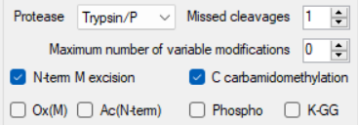
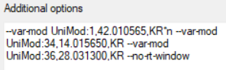
Existing methods for modification searches in DIA data are potentially less sensitive and costly
Experimental spectral library
DDA
Sensitivity and time+resources
DIA-NN
Predicted spectral library
Kong et al. Nature Methods (2017); Demichev et al. Nature methods (2019)

Slide 10
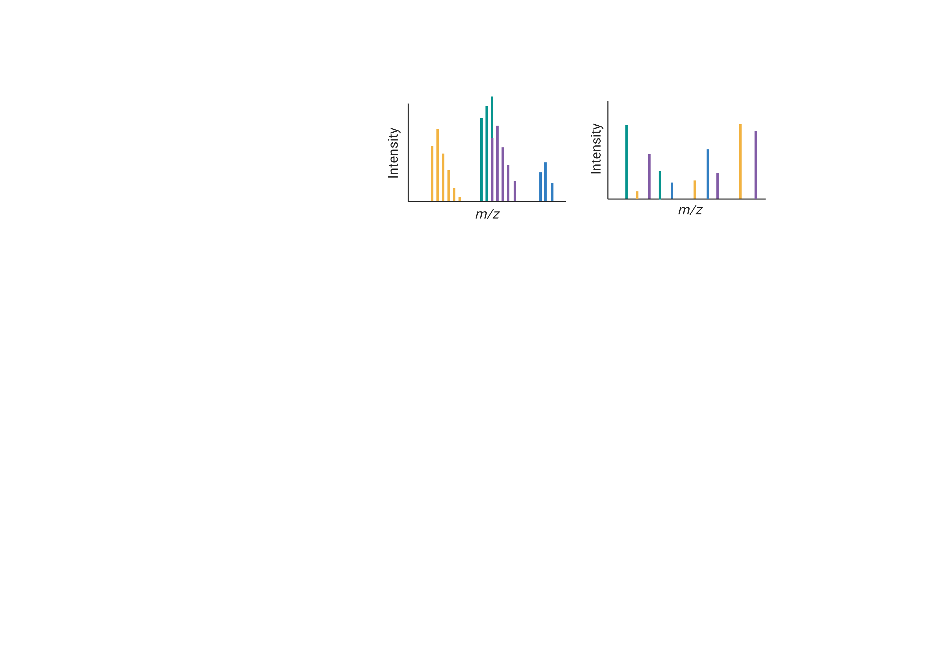
Existing methods for modification searches in DIA data are potentially less sensitive and costly
Experimental spectral library
DDA
Sensitivity and time+resources
DIA-NN
Predicted spectral library
Spectral deconvolution (pseudospectra)
Pseudospectrum
MS2
Kong et al. Nature Methods (2017); Demichev et al. Nature methods (2019)

Slide 11
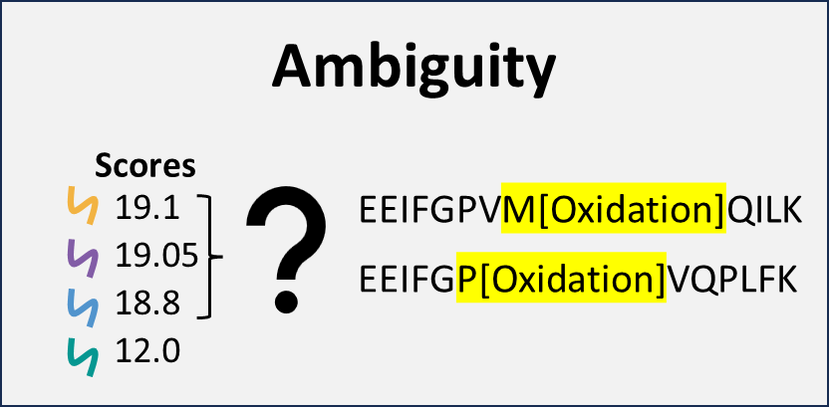
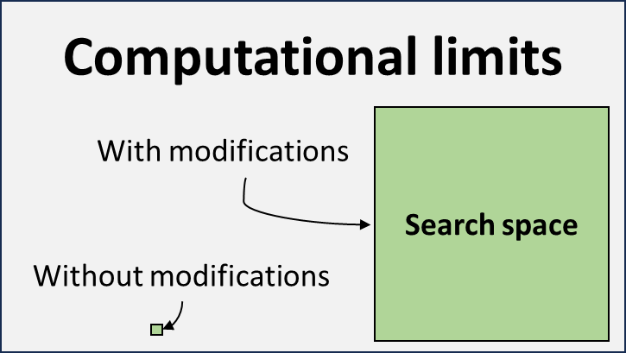
Modification search in DIA – theoretical analysis
Root cause of issues for identification of modified peptides
Computational limits
Ambiguity
Increased ambiguity
No exact precursor info
Chimeric spectra
Peptide centric approach
Computational speed and memory
Modified peptides behave different
Prediction accuracy for spectral library

Slide 12

What are issues with open modification searches, and which are specific to DIA analysis
MS1
MS2
DDA
DIA
Ambiguity
Computational limits
Scores
With modifications
Search space
19.1
19.05
18.8
12.0
EEIFGPVM[Oxidation]QILK
EEIFGP[Oxidation]VQPLFK
Without modifications

Slide 13
Modification search in DIA – theoretical analysis
Root cause of issues for identification of modified peptides
Computational limits
Ambiguity
Increased ambiguity
No exact precursor info
Chimeric spectra
Peptide centric approach
Computational speed and memory
Modified peptides behave different
Prediction accuracy for spectral library

Slide 14
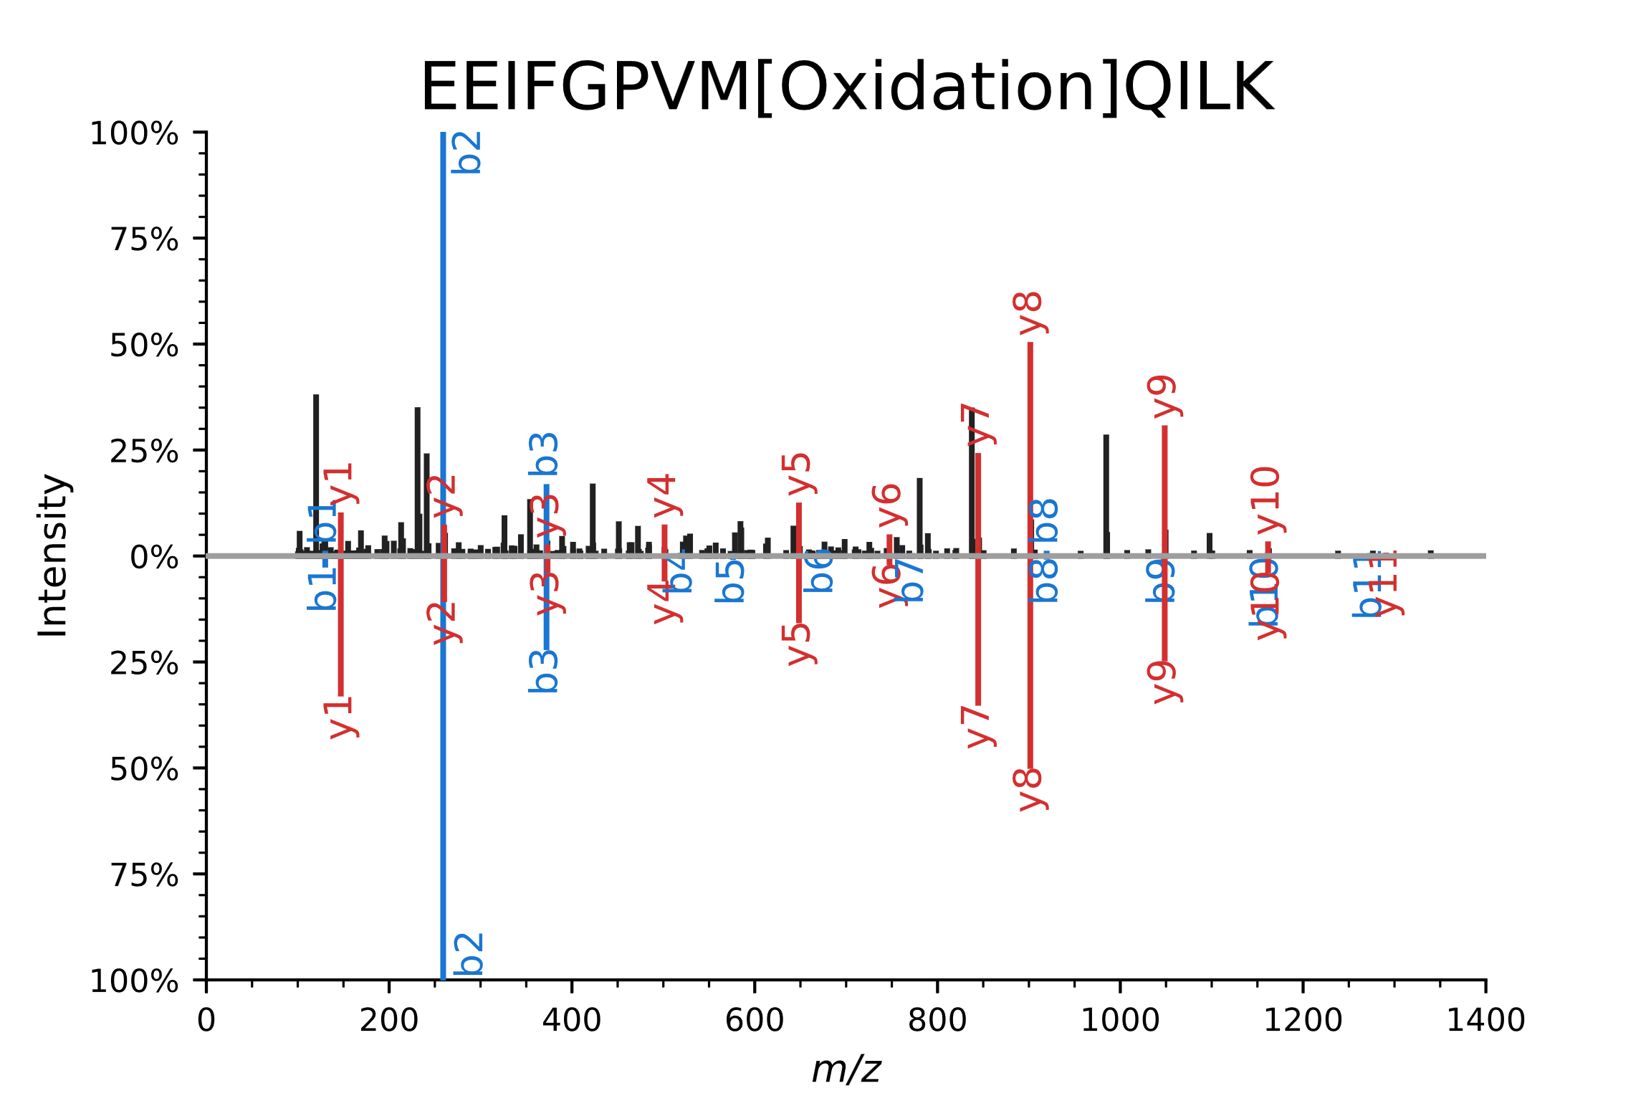
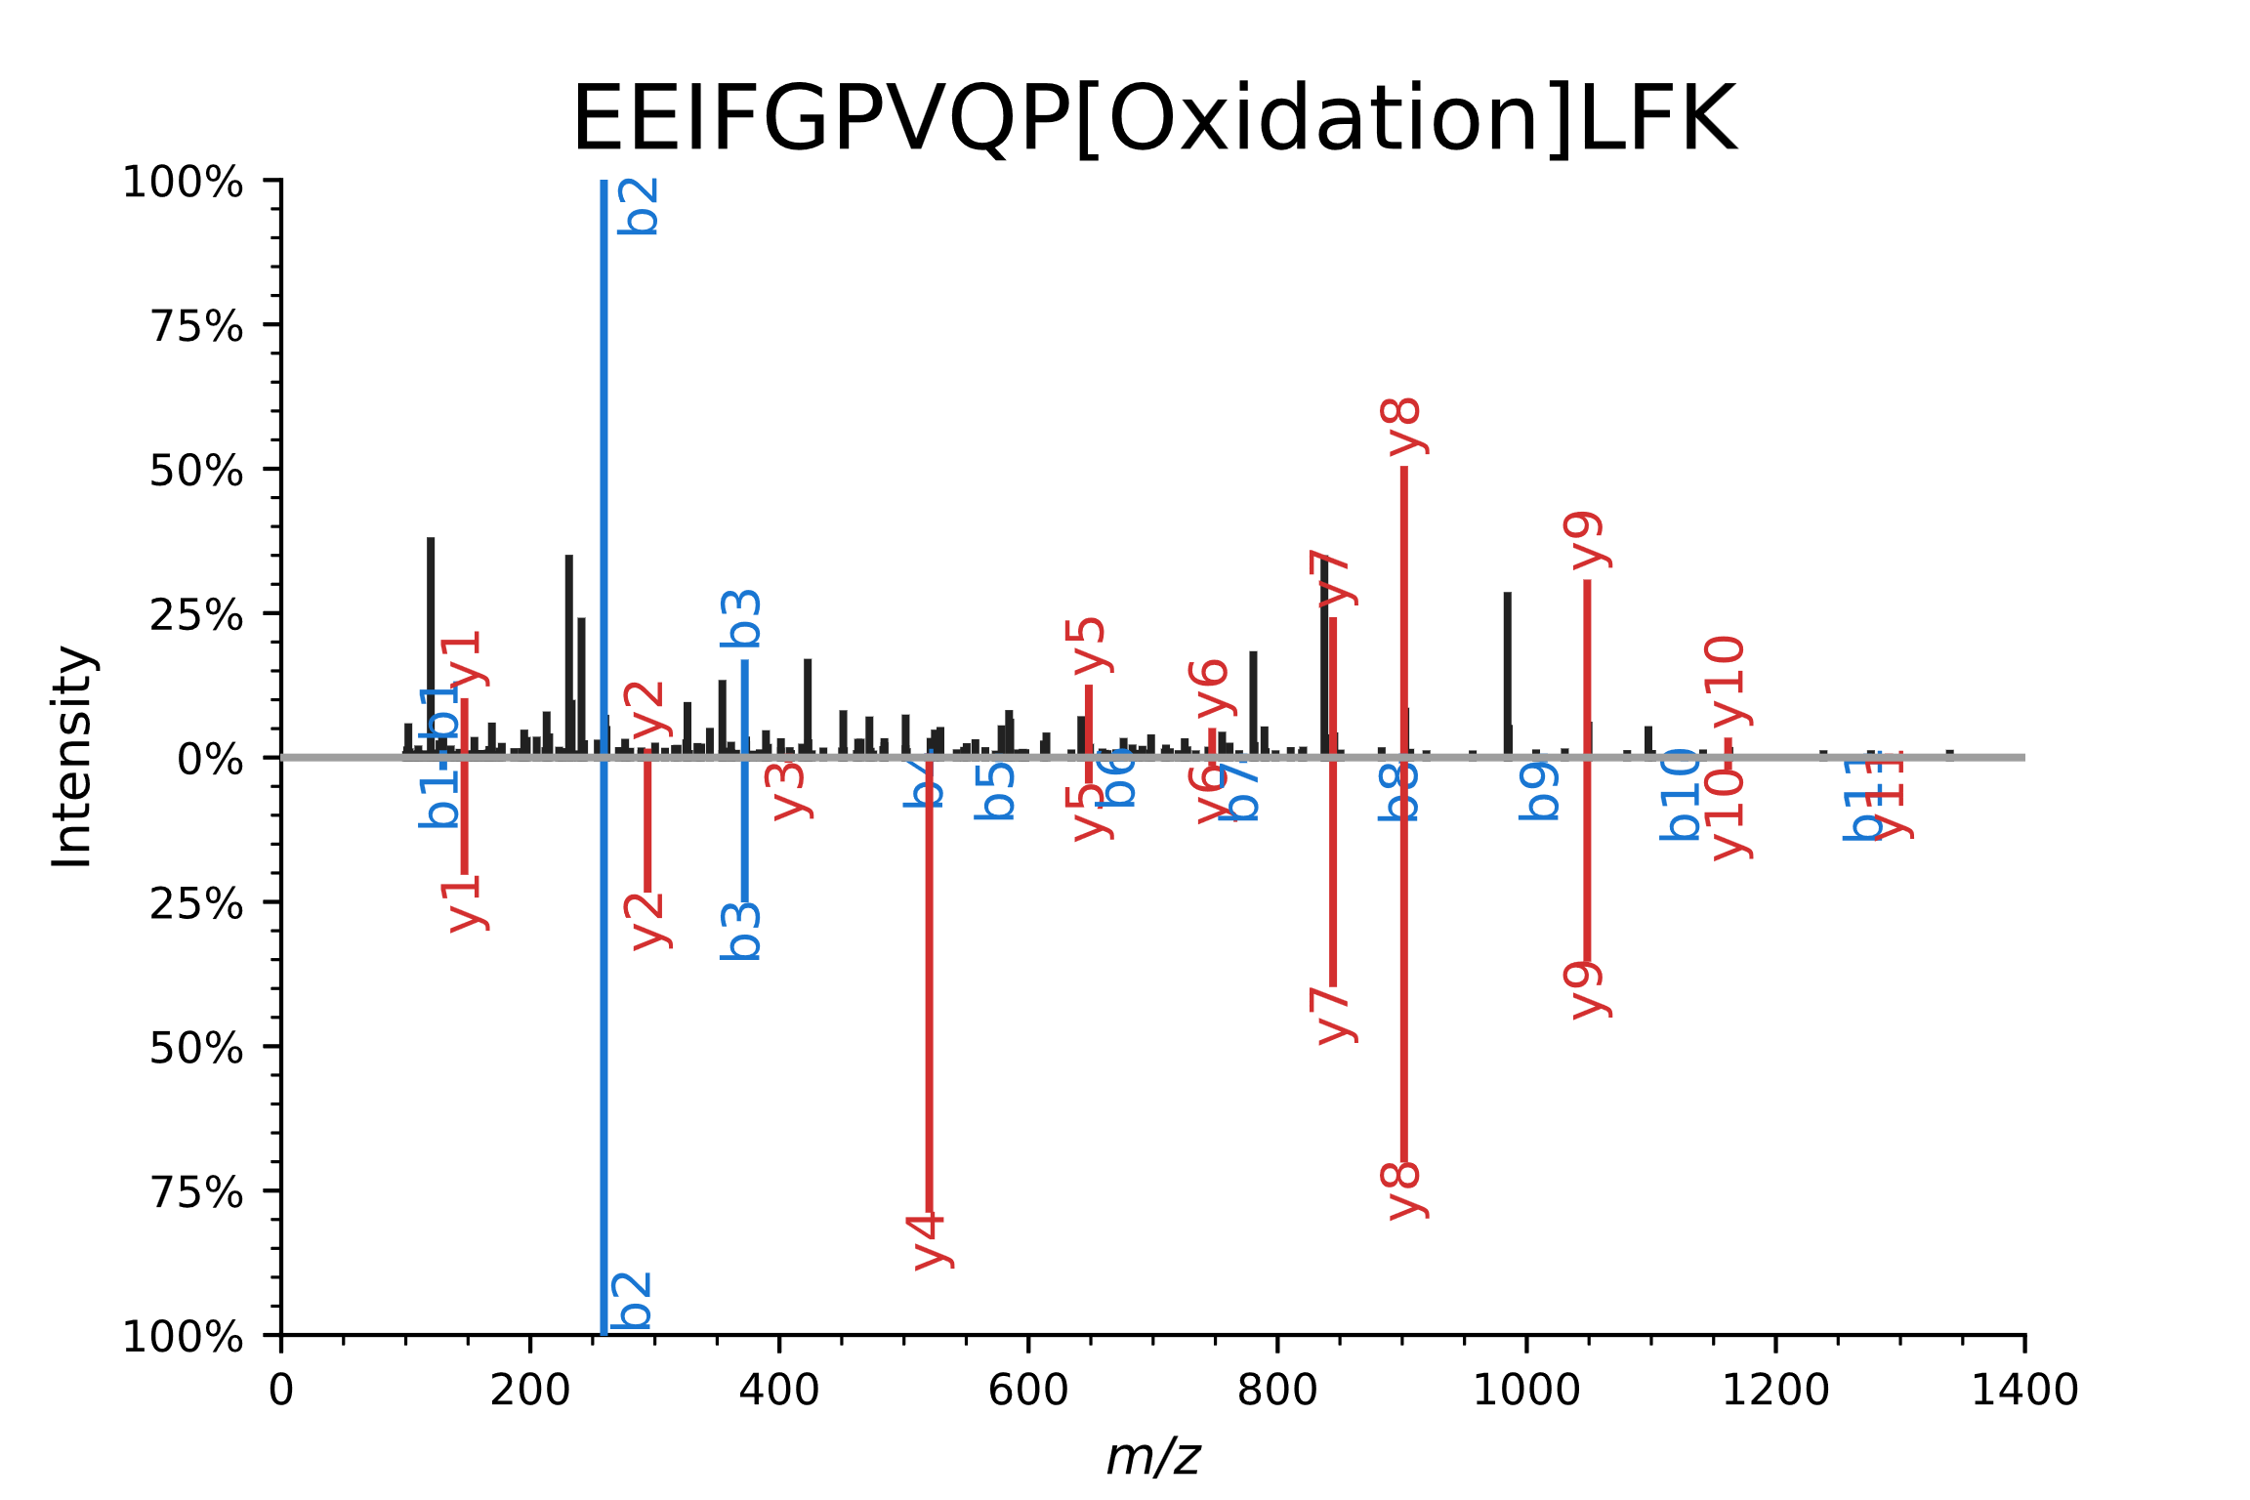
Ambiguity is an issue that is partly resolved with deep learning; in DIA the issue is exacerbated
EEIFGPVM[Oxidation]QILK
EEIFGP[Oxidation]VQPLFK
Notes:
The last decade in CompOmics have developed tools to resolve this ambiguity with ML-models that predict LC-MS peptide behavior.
Now with the prediction of fragment intensity and retention time it is very clear it is more likely the peptide on the left is the true identification.
In my project I will leverage machine learning predictions to resolve the large ambiguity in DIA data to enable multimodification searches.

Slide 15


Ambiguity is an issue that is partly resolved with deep learning; in DIA the issue is exacerbated
EEIFGPVM[Oxidation]QILK
EEIFGP[Oxidation]VQPLFK
Predicted retention time (min): 55.02
Observed retention time (min): 55.36
Predicted retention time (min): 38.02
Observed retention time (min): 55.36
Gabriels et al. NAR (2019); Bouwmeester et al. Nature Methods (2021)
Notes:
The last decade in CompOmics have developed tools to resolve this ambiguity with ML-models that predict LC-MS peptide behavior.
Now with the prediction of fragment intensity and retention time it is very clear it is more likely the peptide on the left is the true identification.
In my project I will leverage machine learning predictions to resolve the large ambiguity in DIA data to enable multimodification searches.

Slide 16
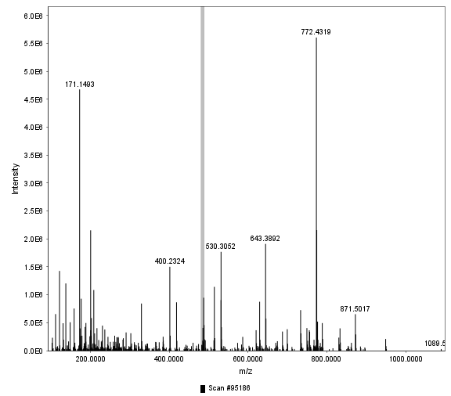
Regardless of acquisition, number of variable modifications is linked to more ambiguity
Δm/z = 229.0831

Slide 17
Regardless of acquisition, number of variable modifications is linked to more ambiguity
[“DGG”, “ND”, “NN[Deamidated]”, …]
[229.06986, 229.06987, 229.06988, …]
Δm/z = 229.0831

Slide 18
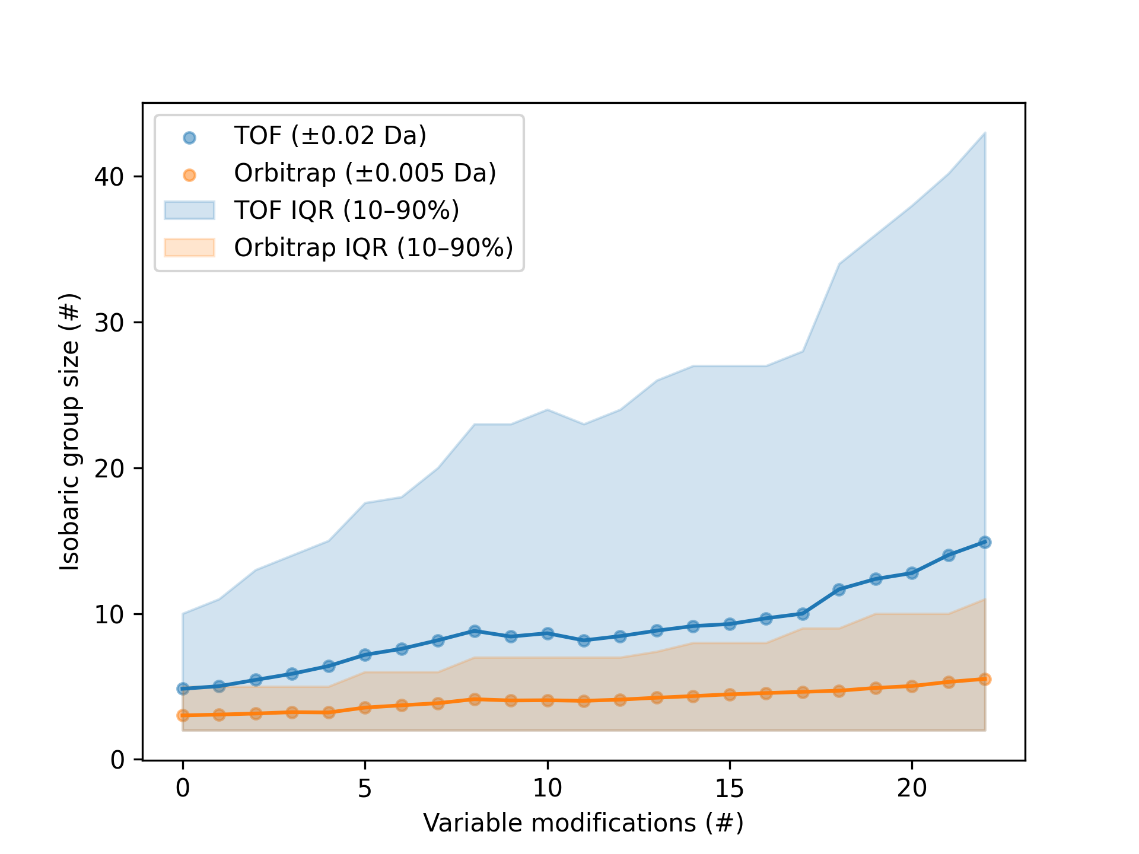
Regardless of acquisition, number of variable modifications is linked to more ambiguity
Human SP fasta –
one to trimers (no positional isomers)
[“DGG”, “ND”, “NN[Deamidated]”, …]
[229.06986, 229.06987, 229.06988, …]
[“DGG”, “ND”, “NN[Deamidated]”, …]
Δm/z = 229.0831

Slide 19
Modification search in DIA – theoretical analysis
Root cause of issues for identification of modified peptides
Computational limits
Ambiguity
Increased ambiguity
No exact precursor info
Chimeric spectra
Peptide centric approach
Computational speed and memory
Modified peptides behave different
Prediction accuracy for spectral library

Slide 20

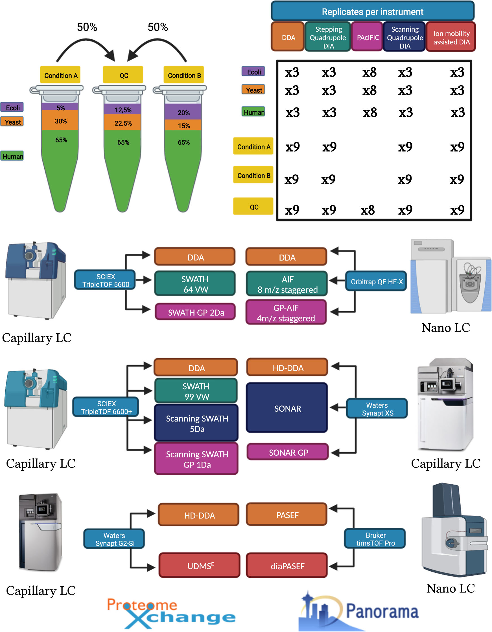

A comprehensive LFQ benchmark dataset on modern day acquisition strategies in proteomics
Bart Van Puyvelde
Maarten Dhaenens
Van Puyvelde et al. Scientific Data (2022)

Slide 21
A comprehensive LFQ benchmark dataset on modern day acquisition strategies in proteomics
Bart Van Puyvelde
Maarten Dhaenens
Van Puyvelde et al. Scientific Data (2022)

Slide 22
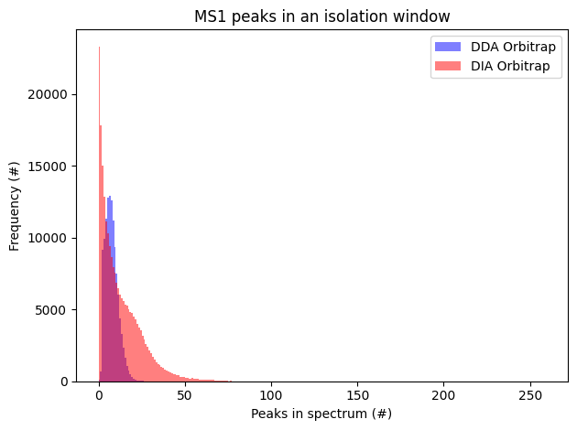
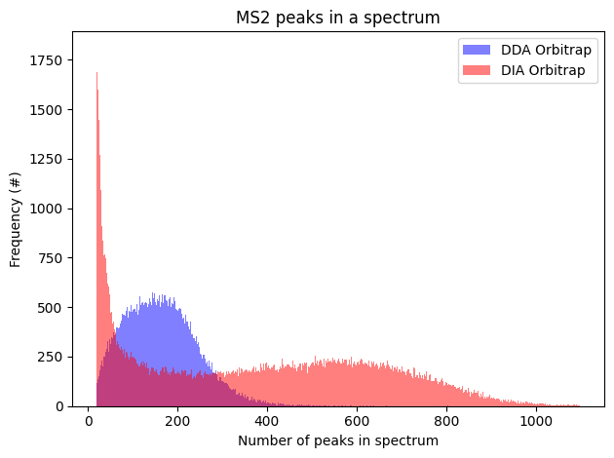
DIA data acquired on the orbitrap shows more than triple the number of peaks in MS1 and MS2
(isolation window ~ 8 m/z)
Peaks in the isolation window (#)
Peaks in an MS2 spectrum (#)

Slide 23
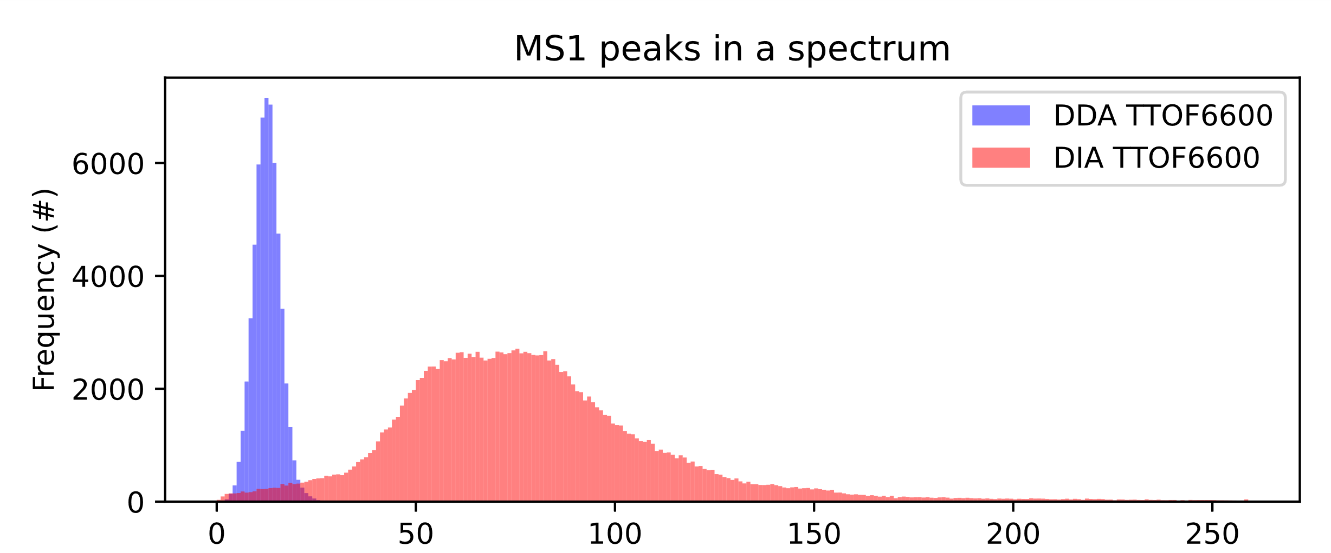
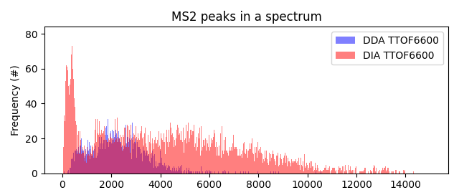
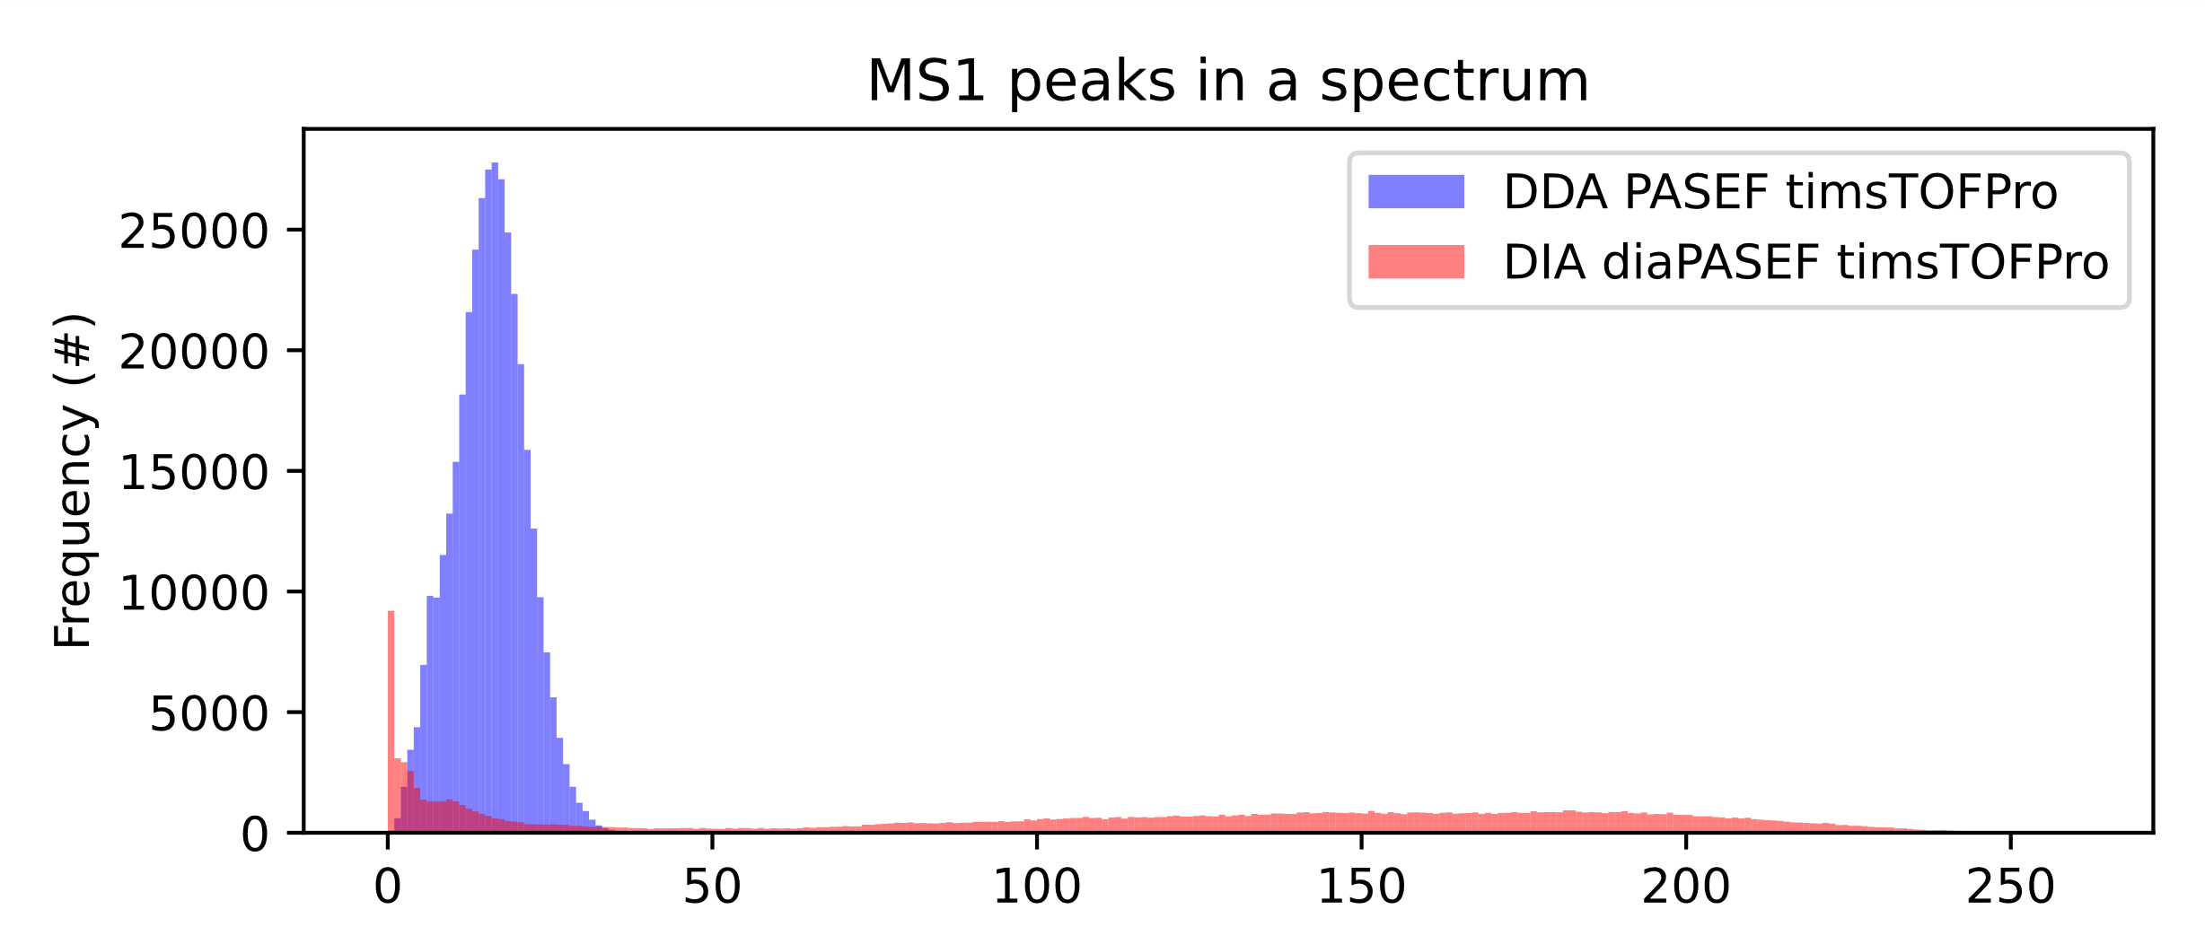
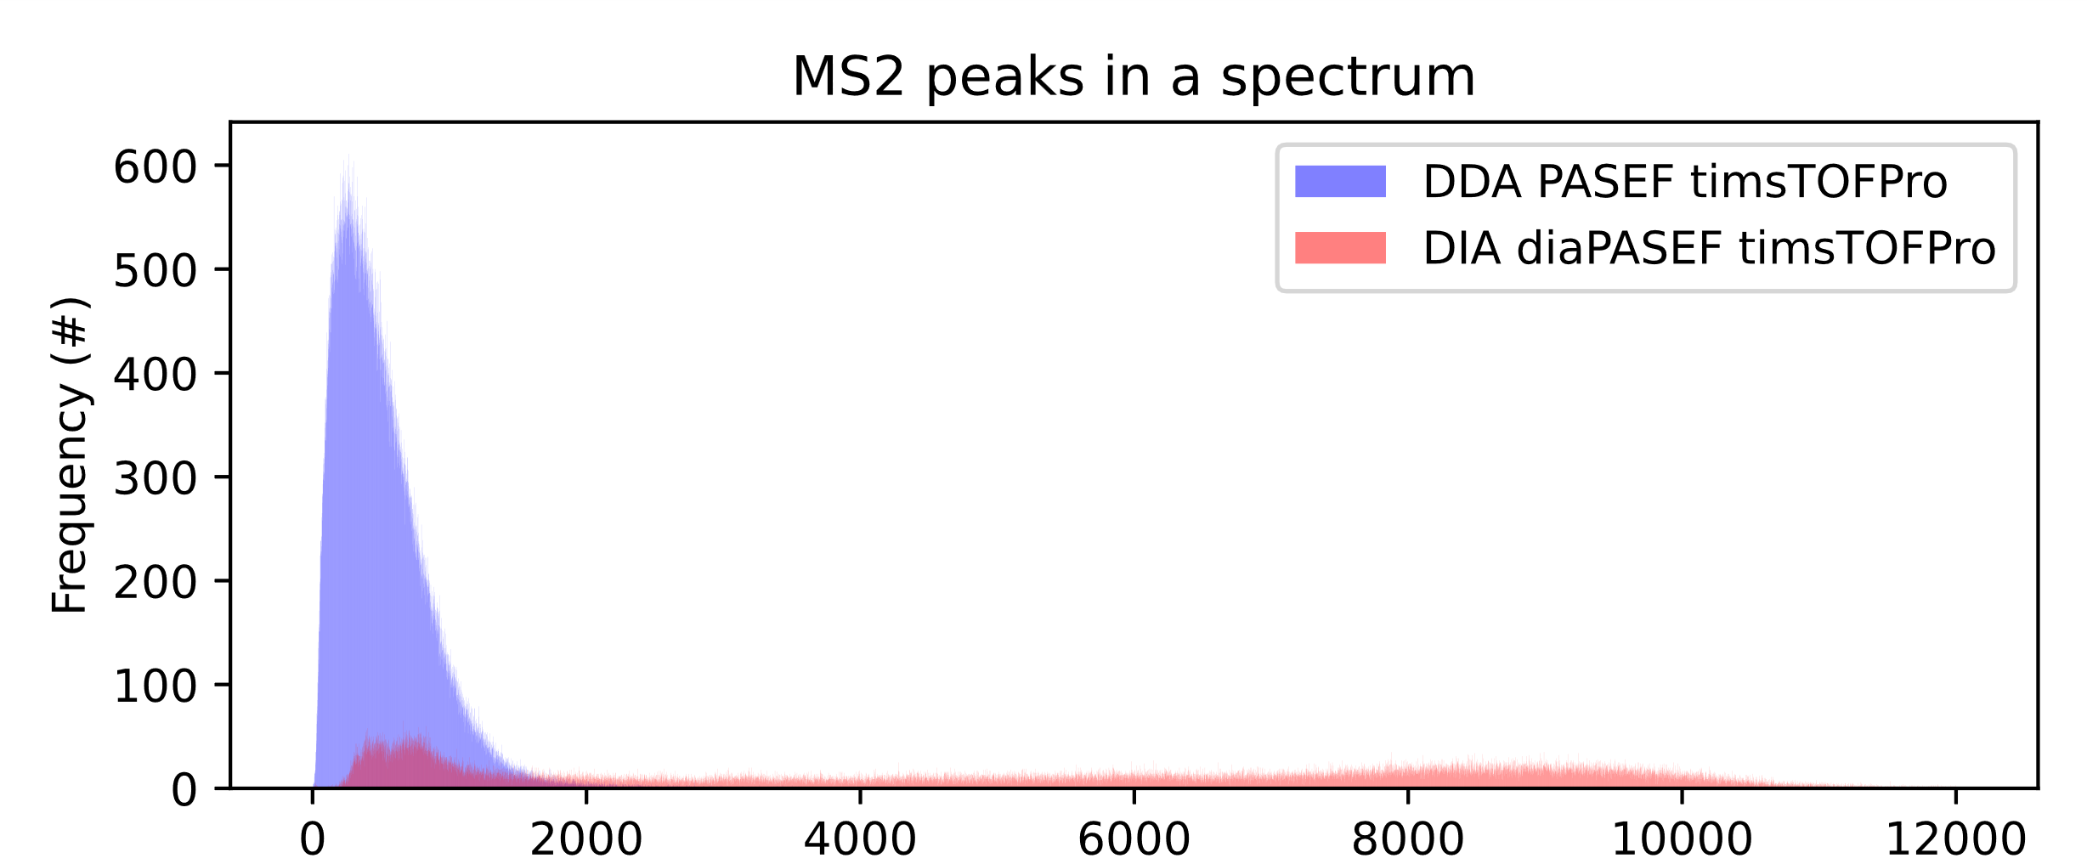
DIA data acquired on TOF instruments show more than six times the number of peaks in MS1 and MS2
(isolation window ~ 8 m/z)
Peaks in the isolation window (#)
Peaks in an MS2 spectrum (#)
(isolation window ~ 26 m/z)
Peaks in the isolation window (#)
Peaks in an MS2 spectrum (#)

Slide 24
Quantifying the multi-interpretability with Δm/z values of all pairwise distances (singlemers)
 | Spectrum 1 | …
F (102.079) | 1 | …
G (57.0215) | 2 | …
I/L (113.084) | 1 | …
… | … | …
Δm/z = 102.079
Δm/z = 113.084

Slide 25
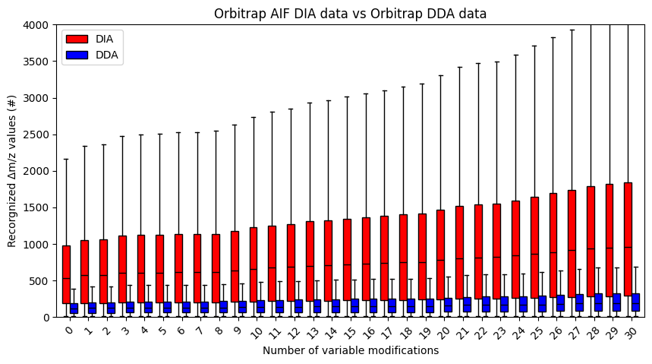
The number of recognized mass shifts for DIA data acquired on the orbitrap has a median that is five times higher

Slide 26
Modification search in DIA – theoretical analysis
Root cause of issues for identification of modified peptides
Computational limits
Ambiguity
Increased ambiguity
No exact precursor info
Chimeric spectra
Peptide centric approach
Computational speed and memory
Modified peptides behave different
Prediction accuracy for spectral library

Slide 27
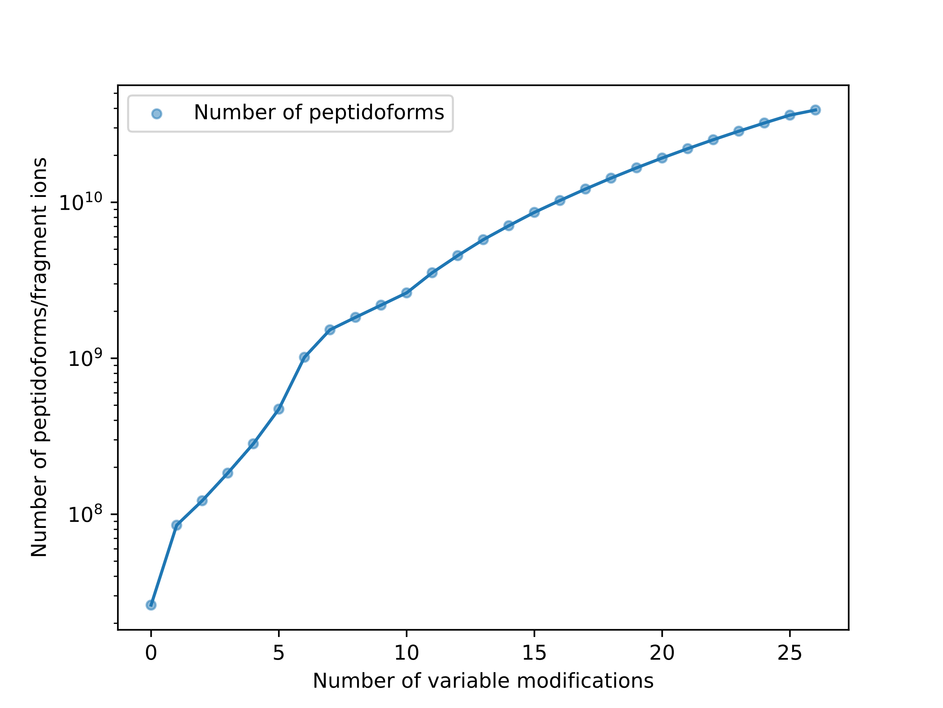
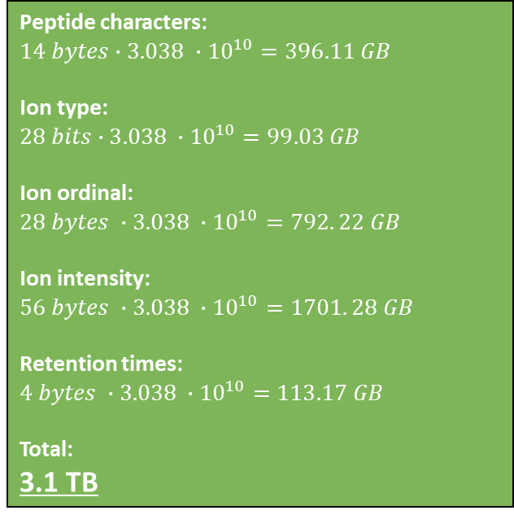
Peptide-centric approach and predicted spectral libraries are computationally infeasible; smart filtering of candidates and predictions on demand
Peptide characters:
$$14 bytes∙3.038 ∙{10}^{10}=396.11 GB$$
Ion type:
$$28 bits∙3.038 ∙{10}^{10}=99.03 GB$$
Ion ordinal:
$$28 bytes ∙3.038 ∙{10}^{10}=792. 22 GB$$
Ion intensity:
$$56 bytes ∙3.038 ∙{10}^{10}=1701. 28 GB$$
Retention times:
$$4 bytes ∙3.038 ∙{10}^{10}=113.17 GB$$
Total:
3.1 TB
6.53 GB

Slide 28
Modification search in DIA – theoretical analysis
Root cause of issues for identification of modified peptides
Computational limits
Ambiguity
Increased ambiguity
No exact precursor info
Chimeric spectra
Peptide centric approach
Computational speed and memory
Modified peptides behave different
Prediction accuracy for spectral library

Slide 29
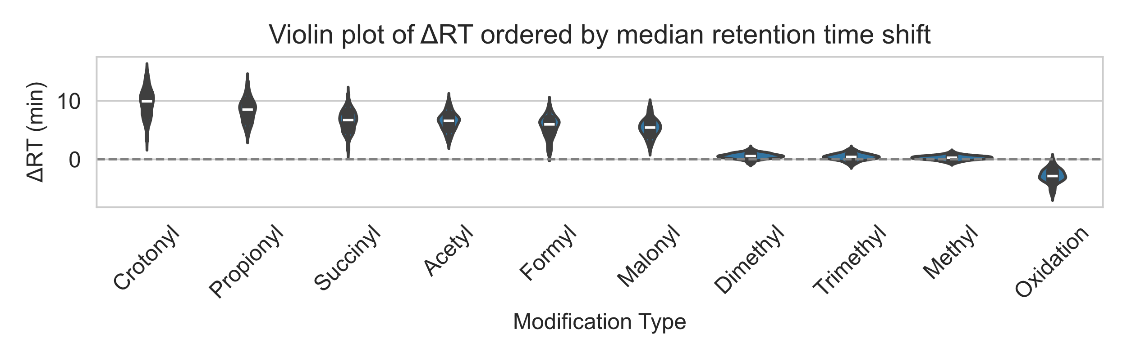
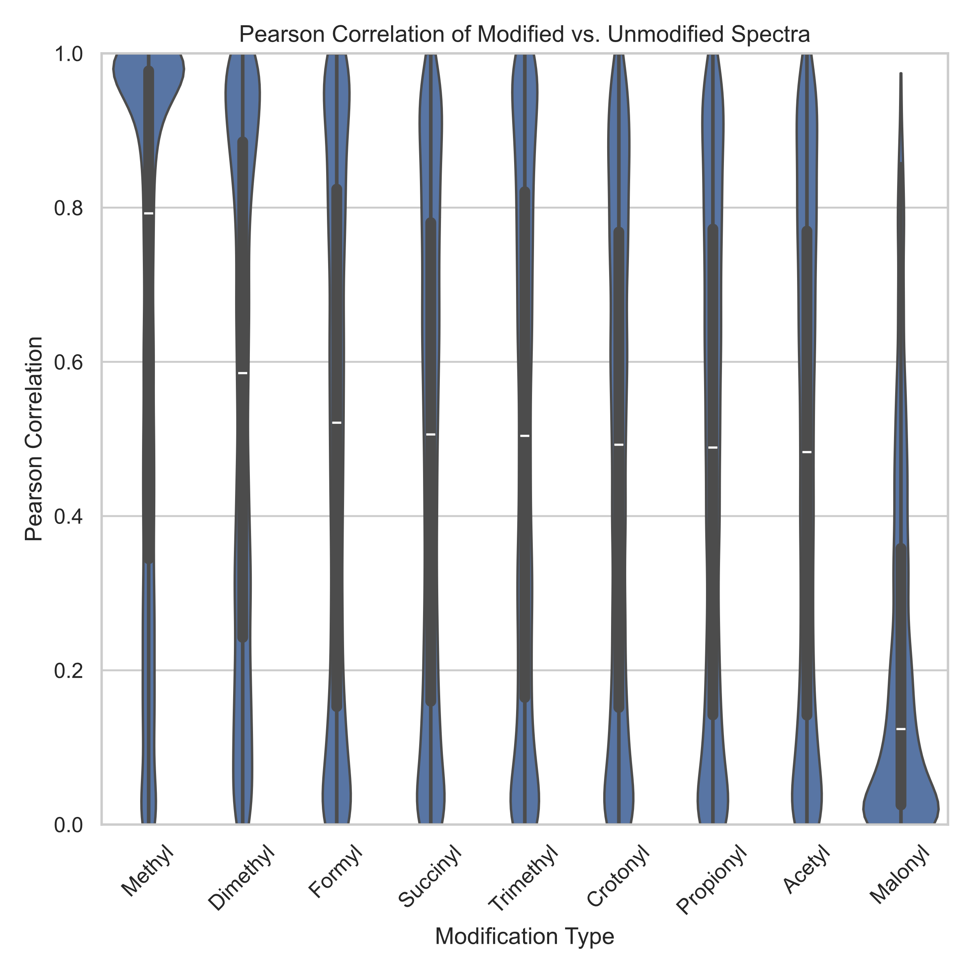
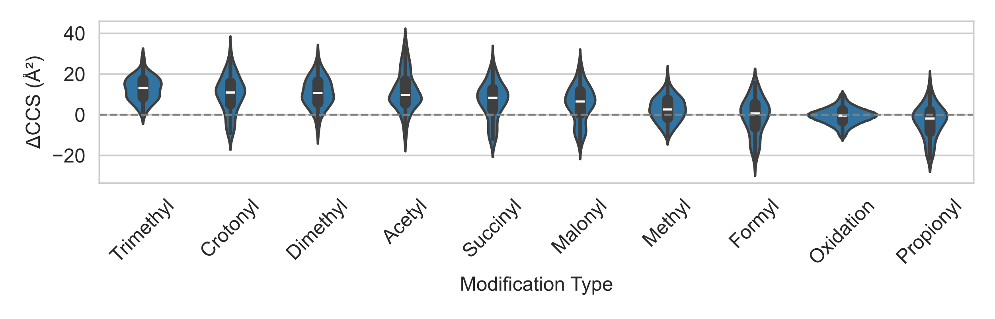
Modified peptides behave substantially different compared to their non-modified counterparts
Zolg et al. MCP (2018); Will et al. Analytical & Bioanalytical Chemistry (2023)

Slide 30
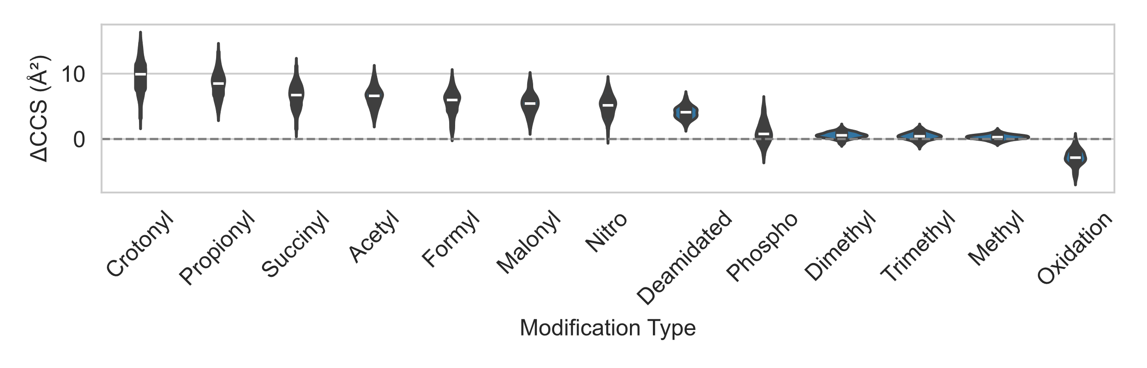
Modified peptides behave substantially different compared to their non-modified counterparts
Zolg et al. MCP (2018); Will et al. Analytical & Bioanalytical Chemistry (2023)

Slide 31
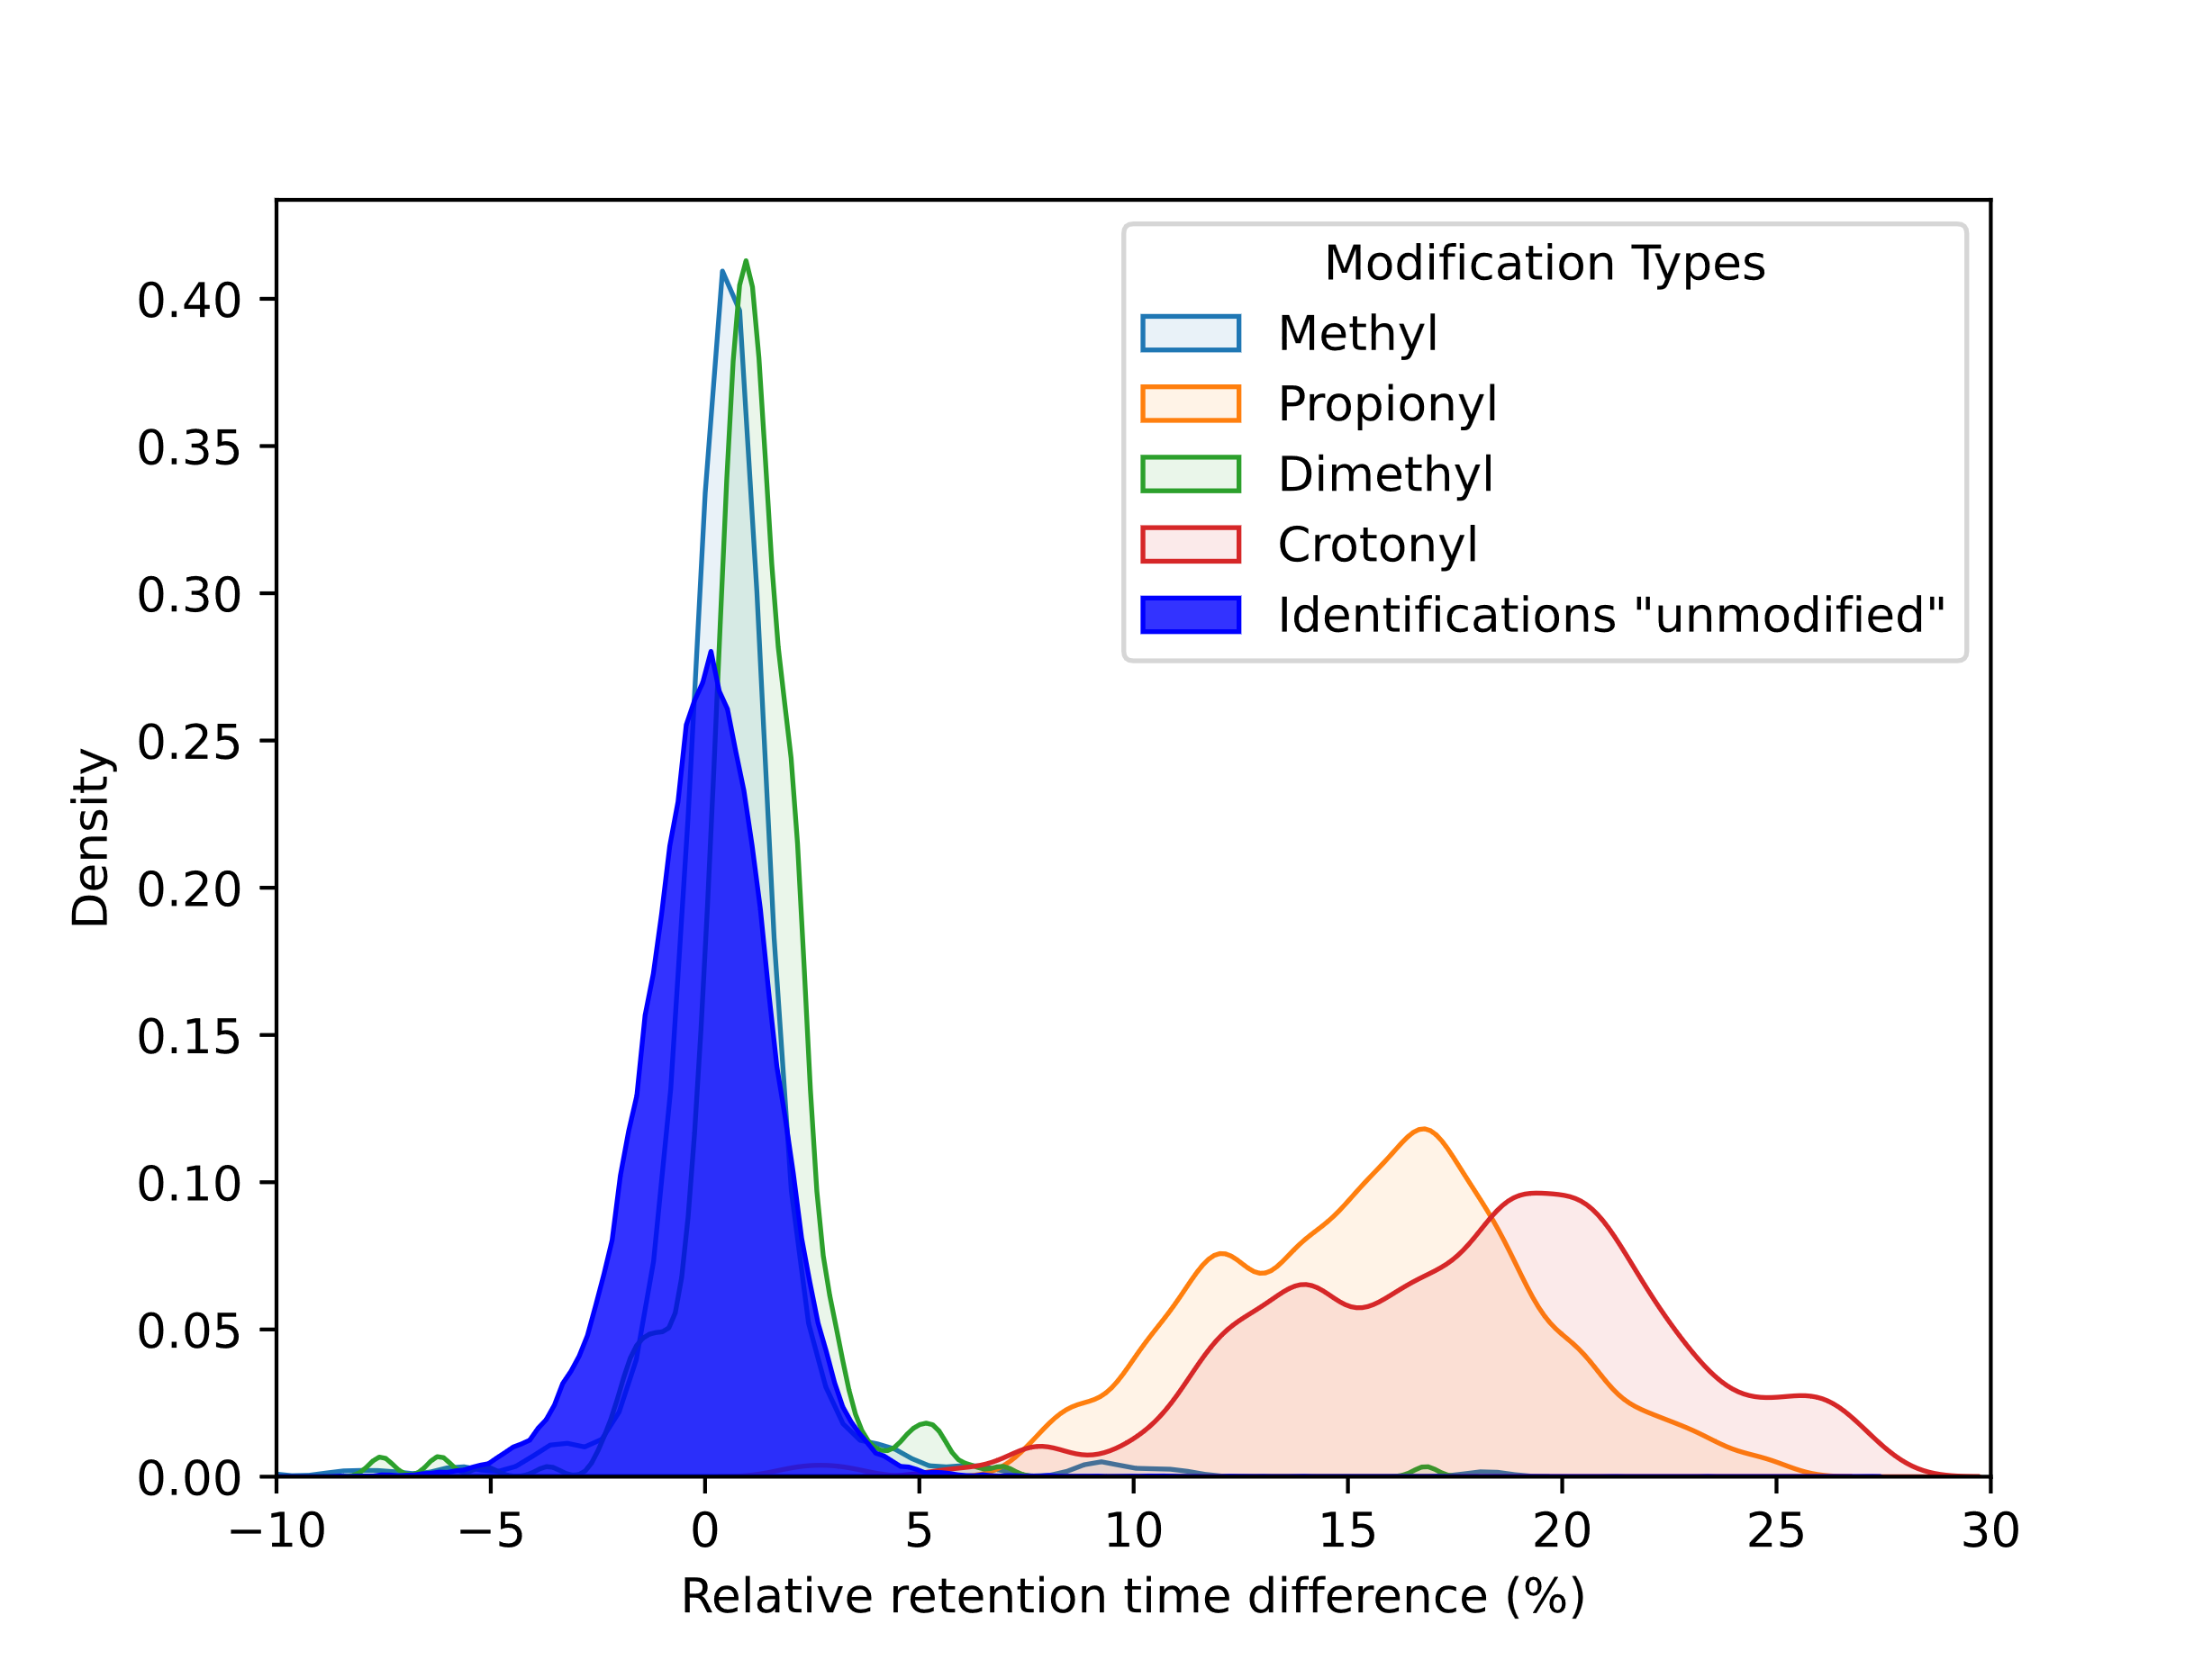
Modifications can shift the retention time outside of the expected range, this has great consequences

Slide 32




Use modification aware behavior predictors when interested in peptide modifications
pDeep3
AlphaPeptDeep
Zeng et al. Nature Communications (2022); Tarn et al. Analytical Chemistry (2021); Declercq & Devreese et al. JPR (2025)

Slide 33
Conclusions and outlook
Existing methods (DDA library and pseudospectra) are likely less sensitive and costly in terms of resources and time
DIA data is inherently more convoluted and thus has substantially higher identification ambiguity compared to DDA data, especially for modification searches
Resolving Ambiguity
Accurate predictions for (unseen) modified peptides (DeepLC, IM2Deep, MS2DIP, PDeep3, AlphaPeptDeep, Prosit-PTM, …)
Transfer learning/fine-tuning to specific instruments
Rescoring with deconvolution features
Computational feasibility
Peptide centric approach is likely unfeasible (~500x search space)
Filter the search space (tags, charge state prediction, strict retention time)
Predictions on demand or precalculated databases that are highly indexed (still high storage demands)

Slide 34




















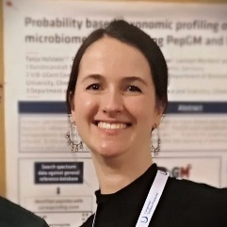








Alexander Kensert
Alireza Nameni
Arthur Declercq
Caroline Jachmann
Enrico Massignani
Harikrishnan Ramadasan
Jasper Zuallaert
Kevin Velghe
Lennart Martens
Lyudmila Kovalchuke
Natalia Tichshenko
Pathmanaban Ramasamy
Patricia Lefèvre
Pieter Verschaffelt
Ralf Gabriels
Toon Callens
Robbe Devreese
Sakina Bombaywala
Sam van Puyenbroeck
Tanja Holstein
Tim Van Den Bossche
Tine Claeys
Daria Fijalkowska
Christophe Vanderaa
Notes:
Then it only leaves for me to thank my supervisors and colleagues for their support, and I am happy to take questions.

Slide 35

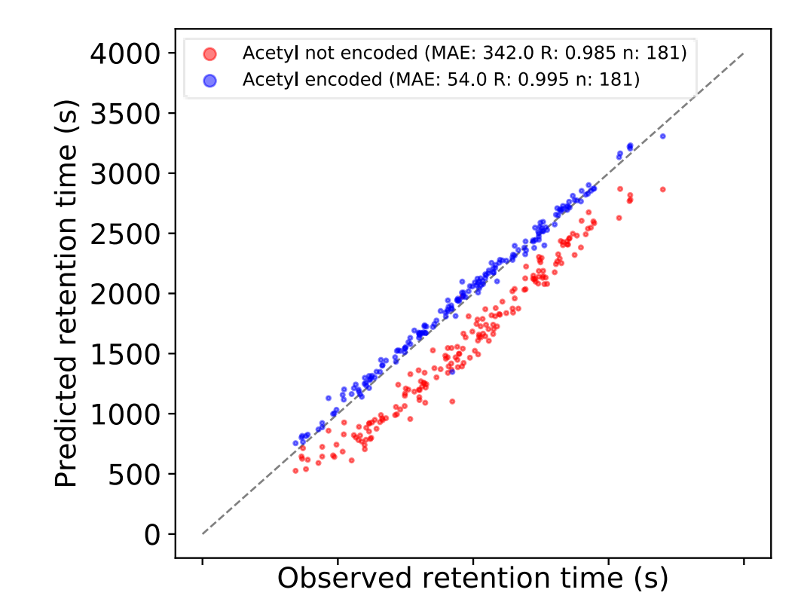
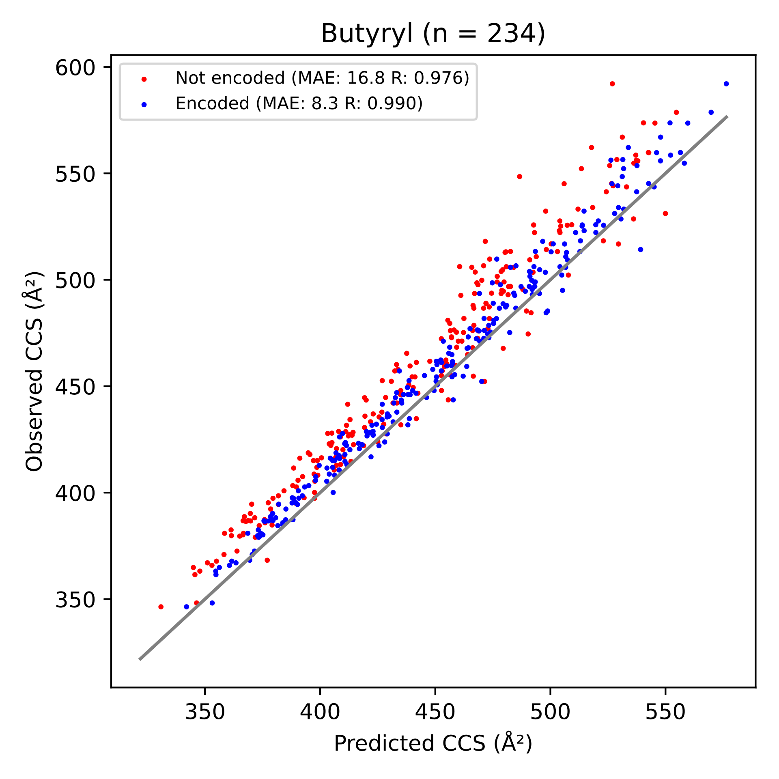
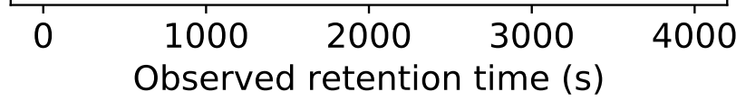
Modification-aware predictors are increasingly available; for example, models for retention times, ion mobility, and fragment intensity
Robbe Devreese
Mean shift due to acetyl: 248 s (6.23%)
Bouwmeester et al. Nature methods (2021)

Slide 36
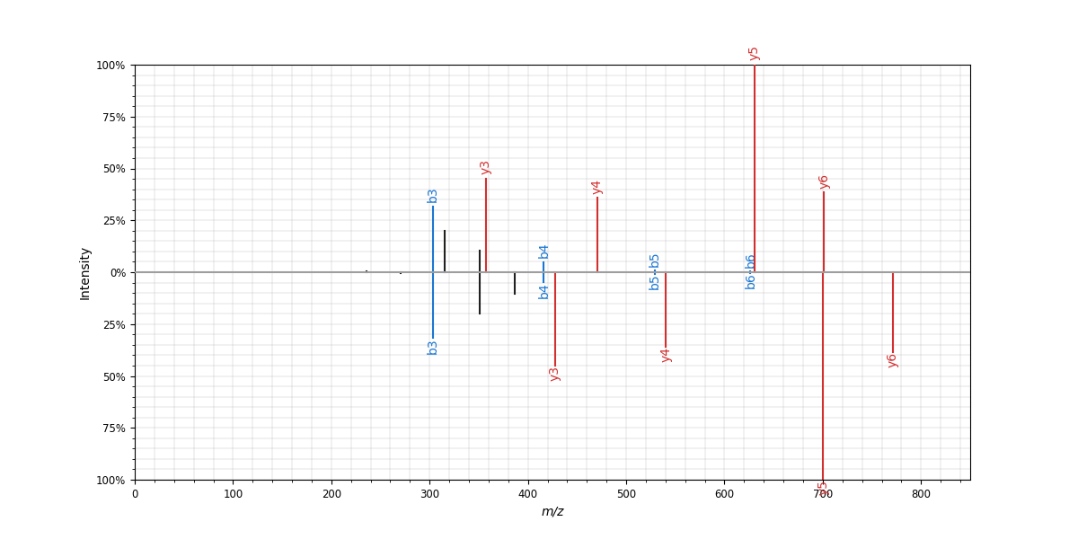
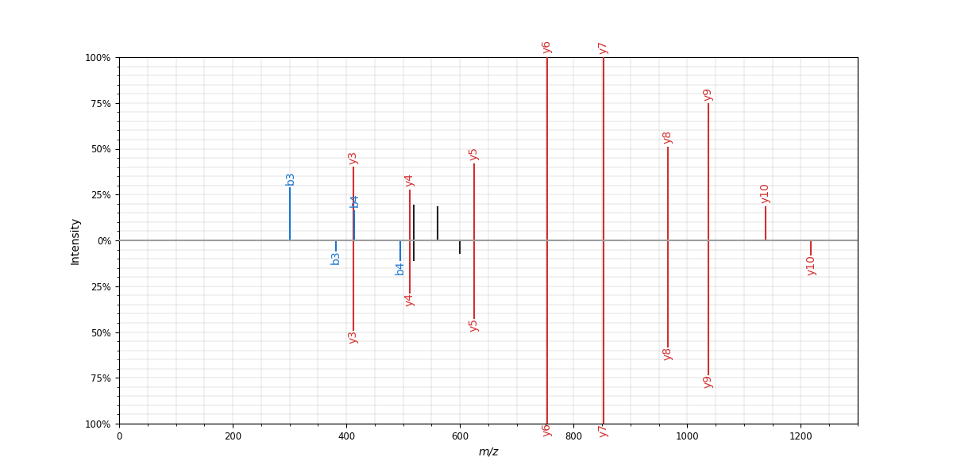
With increased ambiguity, the need for accurate predictions is even higher to resolve ambiguous identifications; unfortunately…
Predictions - Butyryl modified peptide
Predictions - Phospho modified peptide
Sequence: AAC[Carbamidomethyl]LLPK/2
RT: 6.21
Ion mobility: 0.779
Sequence: QTALVELVKHK/2
RT: 14.19
Ion mobility: 1.019
Sequence: AAC[Carbamidomethyl]LLPK[Butyryl]/2
RT: 6.21
Ion mobility: 0.779
Sequence: QT[Phospho]ALVELVKHK/2
RT: 0.26
Ion mobility: 1.024
Bittremieux Anal. Chem. (2019); Demichev et al. Nature methods (2019)

Slide 37
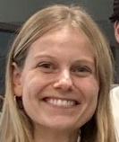
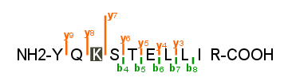
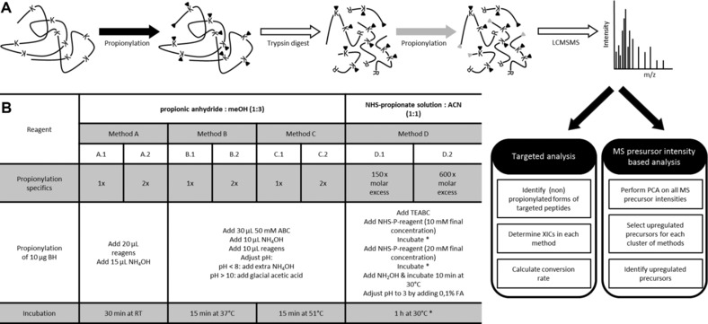
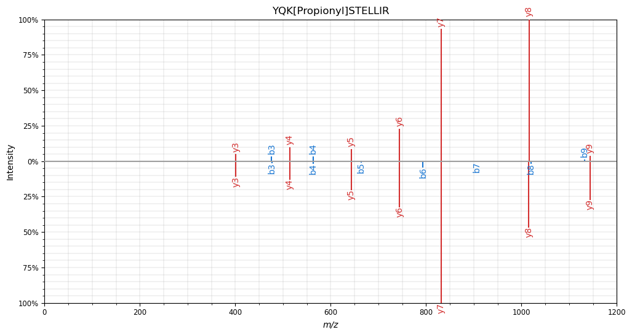
Histone dataset, that is highly modified, shows some of the limitations of DIA-NN predicted libraries
Chemical derivatization of histones for facilitated analysis by mass spectrometry | Nature Protocols
Pitfalls in histone propionylation during bottom‐up mass spectrometry analysis - PMC (nih.gov)
Sigrid Verhelst
Propionylation
Predicted spectrum DIA-NN
Trypsin digest
Maarten Dhaenens
Spectral angle: 0.71
Propionylation
Experimental spectrum

Slide 38
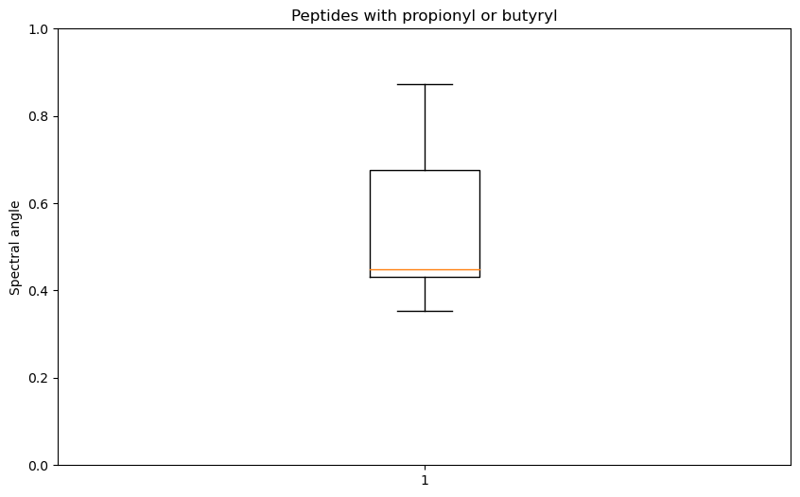
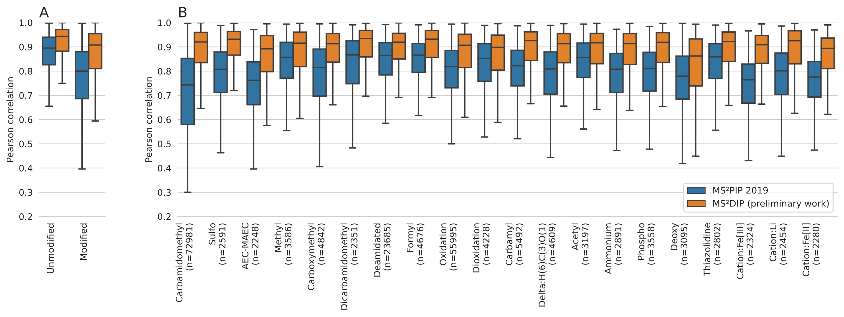
MS2DIP is a modification aware predictor for fragment intensities; histone derived peptides clearly outline the need for these predictors
Ralf Gabriels
ThOG am: Artificial Intelligence in MS Instrumentation and Applications Thursday 8:30
Ballroom AB (Level 3)
MS²DIP: Embracing post-translational modifications for spectrum intensity prediction with molecular embeddings
Declercq et al. MCP (2022)

Slide 39
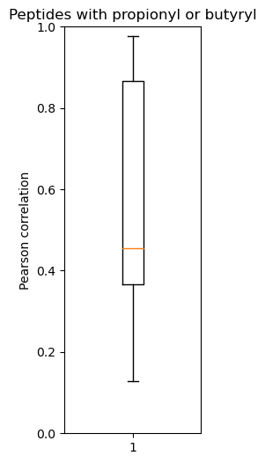
MS2DIP is a modification aware predictor for fragment intensities; histone derived peptides clearly outline the need for these predictors
Declercq et al. MCP (2022)

